Slide 1

Meetup 1.0
SQL/ NoSQL/ NewSQL

Slide 2
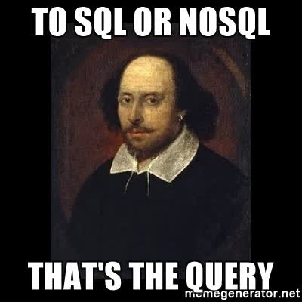
Welcome Note

Slide 3
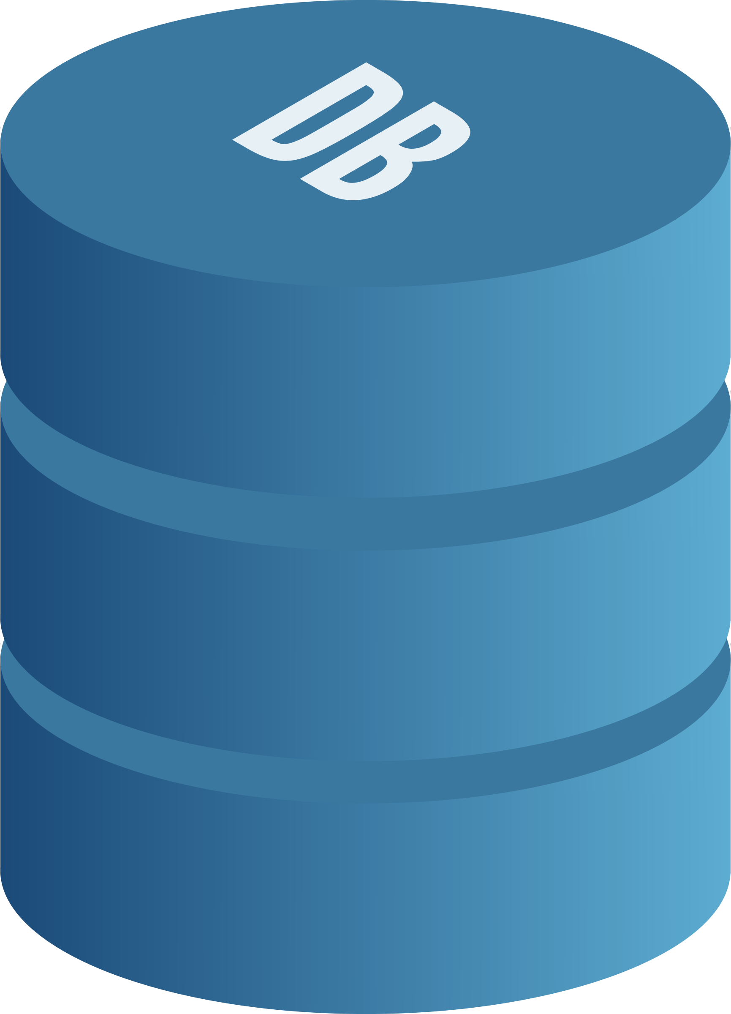
Why this Topic
Transactions and Complex queries
Rich Search and Search Engines
Analytics
Hot Reads
Logging Systems
Web Scale throughput
Notes:
One of the most important tech in our technology stack is database. No matter what application are we designing.. Somewhere in our architecture we will definitely have a database.
It has been an absolute stalwart of our transactional systems, Analytical systems, Payment systems, Reservations systems etc. So what has happened is over the years because of its ubiquity and almost everything we do, we have asked our DB to do a lot for us.
So not surprisingly, Database started to creak under this kind of strain of being able to support all these different kind of workloads. And so we decided to discuss what should be done and what options do we have?

Slide 4

SQL ? NOSQL? NewSQL?
Notes:
SQL is actually a DSL (Domain Specific Language). It is an api for working with data..
It’s one API but there are many ways to represent an API.. And in the past 10 years we have seen the other kinds of API and other ways of working with data. And my hypothesis is that these this multi paradigm approach of dealing with data as NoSQL and NewSQl and whatever you are going to call it is here to stay.
Analogy is that we have many programming languages for many different kinds of tasks so we should have many query languages not just SQL. So let take this one by one.

Slide 5

SQL… My Precious !!!
Edgar F Codd presented his paper “A relational model for data for large shared data banks”
It had been around for about 40 years now.
It sticks to ACID principles (atomicity, consistency, isolation, durability), thus guaranteeing stability, security, and predictability both of the entire database and every transaction in particular.
Good Enough For a majority of tasks!
Major Challenges
Unable to Scale in this mobile generation
Diverse unstructured data
Notes:
SQL has been the dominant force in the market and been around since 1970 when a very brilliant man named Edgar F Codd presented his paper “A relational model for data for large shared data banks” based on which Lord Larry Ellison went on to give the world its first commercial Relational Database System from Oracle. It was a great thing and soon became the most important thing for developers. The thinking in the community went like… We have SQL and we should just use it for everything. But this dominance of SQL took time. It didn’t happen overnight
But then came the problem: Scaling!!!
One of the reasons NoSQL and NewSQL appeared was the fact that old RDBMS weren’t designed to handle the number of transactions modern databases have to deal with every second. Giants like Amazon or Alibaba deal with staggering amounts of data that will choke an old RDBMS in a matter of minutes.

Slide 6

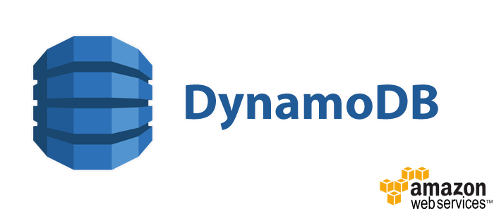







NoSQL..Not Only SQL!
Paper from Google with the title Big Table: A distributed storage system for structured data.
NoSQL databases have existed since the 1960s, but have been recently gaining traction with popular options such as MongoDB, CouchDB, Redis and Apache Cassandra.
So for different use cases different flavours of NoSQL databases begin to emerge.
Followed BASE Compliance and CAP Theorem.
Notes:
The original impetus about a lot of NoSQL solution was really about scale. It all can be traced back to the paper from Google with the title Big Table: A distributed storage system for structured data.
After that Dynamo from Amazon, Cassandra from facebook, Hbase for Hadoop solutions,
ACID (relational) BASE (NoSQL) |Strong consistency-Weak consistency| Isolation- Last write wins| |Transaction-Program managed| Robust database-Simple database| Simple code (SQL)-Complex code| Available and consistent Available and partition-tolerant | Scale-up (limited)-Scale-out (unlimited)| Shared (disk, mem, proc etc.)- Nothing shared (parallellizable) |

Slide 7
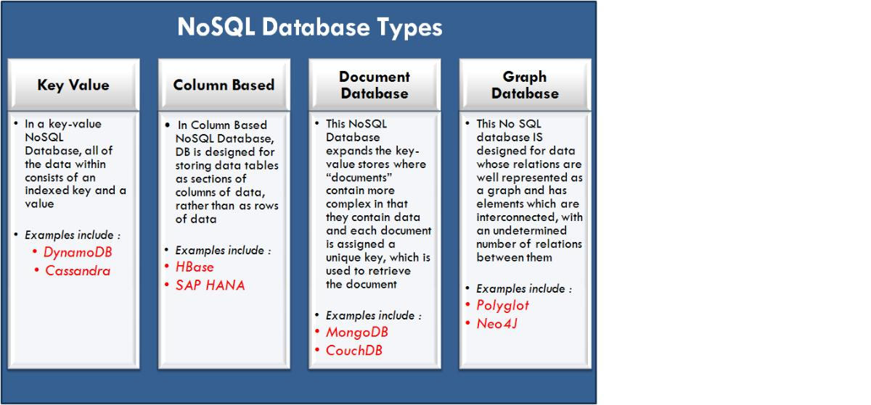
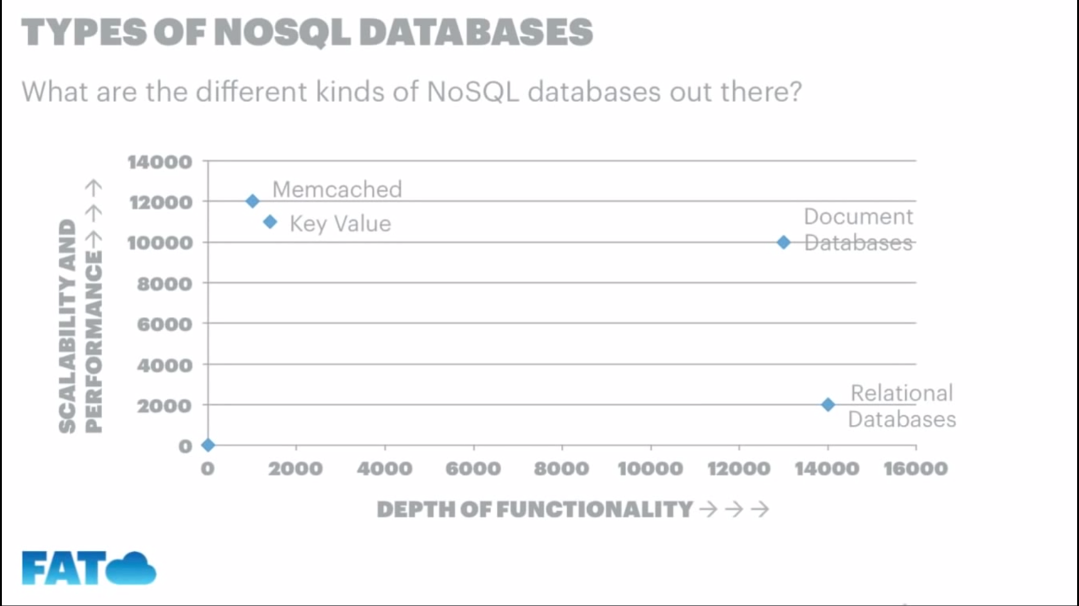
What are these types?
Notes:
Key Value Sore: Associative arrays, Light and compact, Kind of like hash tables, fast reads and writes
Column Storage, Reads are faster than wirtes

Slide 8

Some Key Features of NoSQL DB
1. Schemaless and TableLess
You mean to tell me .. We are free from the tyranny of schemas.
No need to develop a detailed database model: The non-relational nature of a NoSQL database allows database architects to quickly create a database without needing to develop a detailed (fine-grained) database model. This saves a lot of development time.

Slide 9
Some Key Features of NoSQL DB
2. Extremely Scalable Distributed Architecture
Humongous Volume of data.
Can Scale both up and out.
Also most of the time administration does not require large downtimes.
3. Very Powerful for some particular use cases
Humongous Volume of static data- Hbase , Big Table
Fast hot reads- Memcached or Redis
Search Engines- ElasticSearch
Redis for Sorted sets

Slide 10
Industry Leaders analysis
Mongo DB /Couch DB | Redis | Neo4J | HBase
CP/AP Simple Uses BSON/JSON A lot of functionalities similar to a DB. | CP Caching System Can persist information to disk Has complex datatypes Dataset should be less than Ram Size Rarely used alone | High Availability over consistency Can handle huge amount of data Linked is one of the very well known user | CP Column Store for heavy reads Facebook is a prime user HBase runs with Hadoop architecture Good Standalone alternative is Cassandra Cassandra is AP and more suitable for concurrent writes.
Notes:
Redis Datatypes- Expiry caching, lists, sorted sets, hash, messaging architecture
Eventual persistency through taking snapshots
Master election on faliures
Neo4J NO SHARDING – gRAPH Replication

Slide 11
Then what is the problem?
Familiarity
Support is mainly Community Dependent.
Difficult to make reliable transactional applications without ACID compliance.
Many of the variants make less sense in a single server context.
No Joins – What Did I just hear ?
Lack of standardization
Lack of proper Data Integrity
Transactions: Our Stud NoSQL just can’t commit.
Notes:
With NoSQL, and thus without ACID-compliance, it's very difficult to write reliable software even though it follows the CAP theorem. It is clear that without ACID, the developers have to spend a significant fraction of their time building extremely complex and error-prone systems. Also, this totally depends on the business decision and use cases. There is a lot of new development and research taking place to come out with stable NoSQL products.

Slide 12
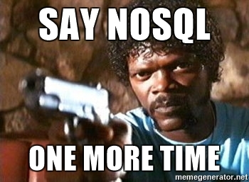
Few Myths To BUST!
MYTH: NoSQL supersedes SQL
MYTH: NoSQL is better / worse than SQL
MYTH: SQL vs NoSQL is a clear distinction
MYTH: the language/framework determines the database
Notes:
MYTH: NoSQL supersedes SQL That would be like saying boats were superseded by cars because they’re a newer technology. SQL and NoSQL do the same thing: store data. They take different approaches, which may help or hinder your project. Despite feeling newer and grabbing recent headlines, NoSQL is not a replacement for SQL — it’s an alternative.
MYTH: NoSQL is better / worse than SQL Some projects are better suited to using an SQL database. Some are better suited to NoSQL. Some could use either interchangeably. Thisdiscussion could never be a SitePoint Smackdown, because you cannot apply the same blanket assumptions everywhere.
MYTH: SQL vs NoSQL is a clear distinction This is not necessarily true. Some SQL databases are adopting NoSQL features and vice versa. The choices are likely to become increasingly blurred, and NewSQL hybrid databases could provide some interesting options in the future.
MYTH: the language/framework determines the database We’ve grown accustom to technology stacks, such as —
LAMP: Linux, Apache, MySQL (SQL), PHP
MEAN: MongoDB (NoSQL), Express, Angular, Node.js
.NET, IIS and SQL Server
Java, Apache and Oracle.
There are practical, historical and commercial reasons why these stacks evolved — but don’t presume they are rules. You can use a MongoDB NoSQL database in your PHP or .NET project. You can connect to MySQL or SQL Server in Node.js. You may not find as many tutorials and resources, but your requirements should determine the database type — not the language.
(That said, don’t make life purposely difficult for yourself! Choosing an unusual technology combination or a mix of SQL and NoSQL is possible, but you’ll find it tougher to find support and employ experienced developers.)

Slide 13

NewSQL..
NewSQL is a relatively new approach that seeks to unite the best of both possible worlds using modern programming languages and technology that wasn’t available before. Its goal is to combine ACID guarantees of SQL with scalability and high performance of NoSQL.
NuoDB, VoltDB, Cloudera Impala
Notes:
Obviously, NewSQL looks quite promising due to combining the advantages that, in the past, existed only separately; and, perhaps, at some point in the future, it will become the standard used by the majority. Unfortunately, currently most NewSQL databases are either proprietary software or only apply to specific scenarios, which significantly limits the spread and adoption of the new technology.
In addition to that, NewSQL is anything but homogenous, and each solution has drawbacks and advantages of its own. For example, SAP HANA can easily handle low-to-medium transactional workloads but doesn’t use native clustering, MemSQL is useful for clustered analytics but shows poor consistency on ACID transactions, and so on. As a result, it will probably be quite a while before these solutions become really widespread.

Slide 14

Factors that decide what to use?
Use Cases
Need To Scale
Type of data (Regularly updating data or static transactional data (Write once read multiple)

Slide 15

Transition
Similar to using an API
Industry Practices – What can be moved and what solution to chose?
Notes:
Sample for : Elastic search + Neo4j + MySQL.
No SQL has so many options that it can get scary at times regarding if we are using the right one or …How much down time are we gonna have ?
Can you consume json, do you have web programmers ?
Not transactional.. Unit of work pattern do we have ? A layer of code ..to do acid transactions for us?
More about the mind set… Rather than the capabilities of the technology.

Slide 16
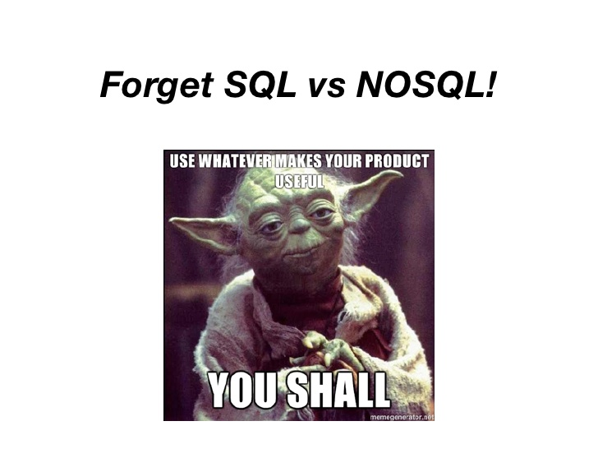
SAMPLE USECASES
Face book messaging
Social Networking – Twitter, Walmart
An application that uses lots of quick reads and writes
An inventory System- CA

Slide 17

Questions

Slide 18


